Slide 1
Capstone Project Update
AuE-8360 Scaled Autonomous Vehicles
Chinmay Samak
PhD Candidate, CU-ICAR
csamak@clemson.edu
Tanmay Samak
PhD Candidate, CU-ICAR
tsamak@clemson.edu

Slide 2
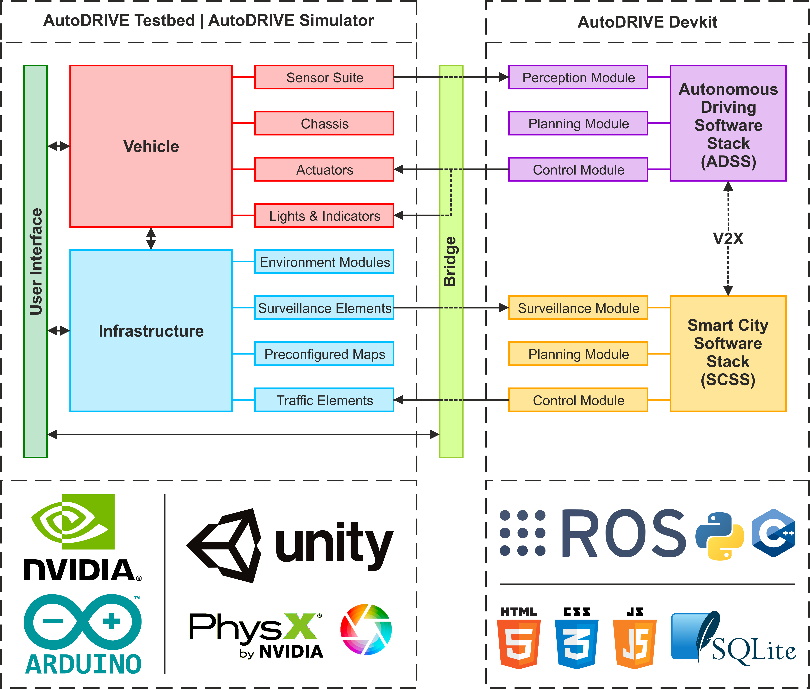
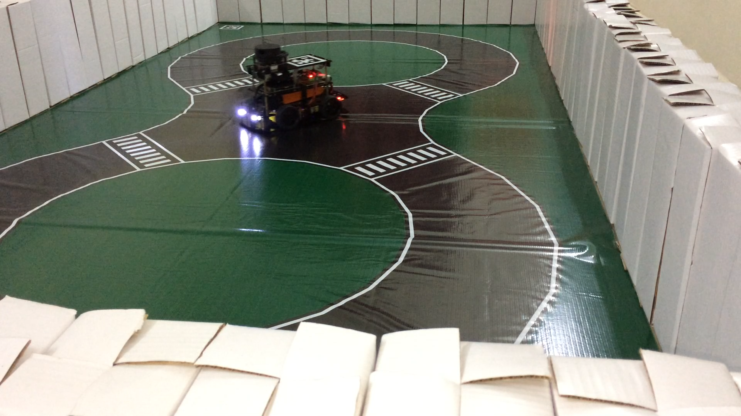
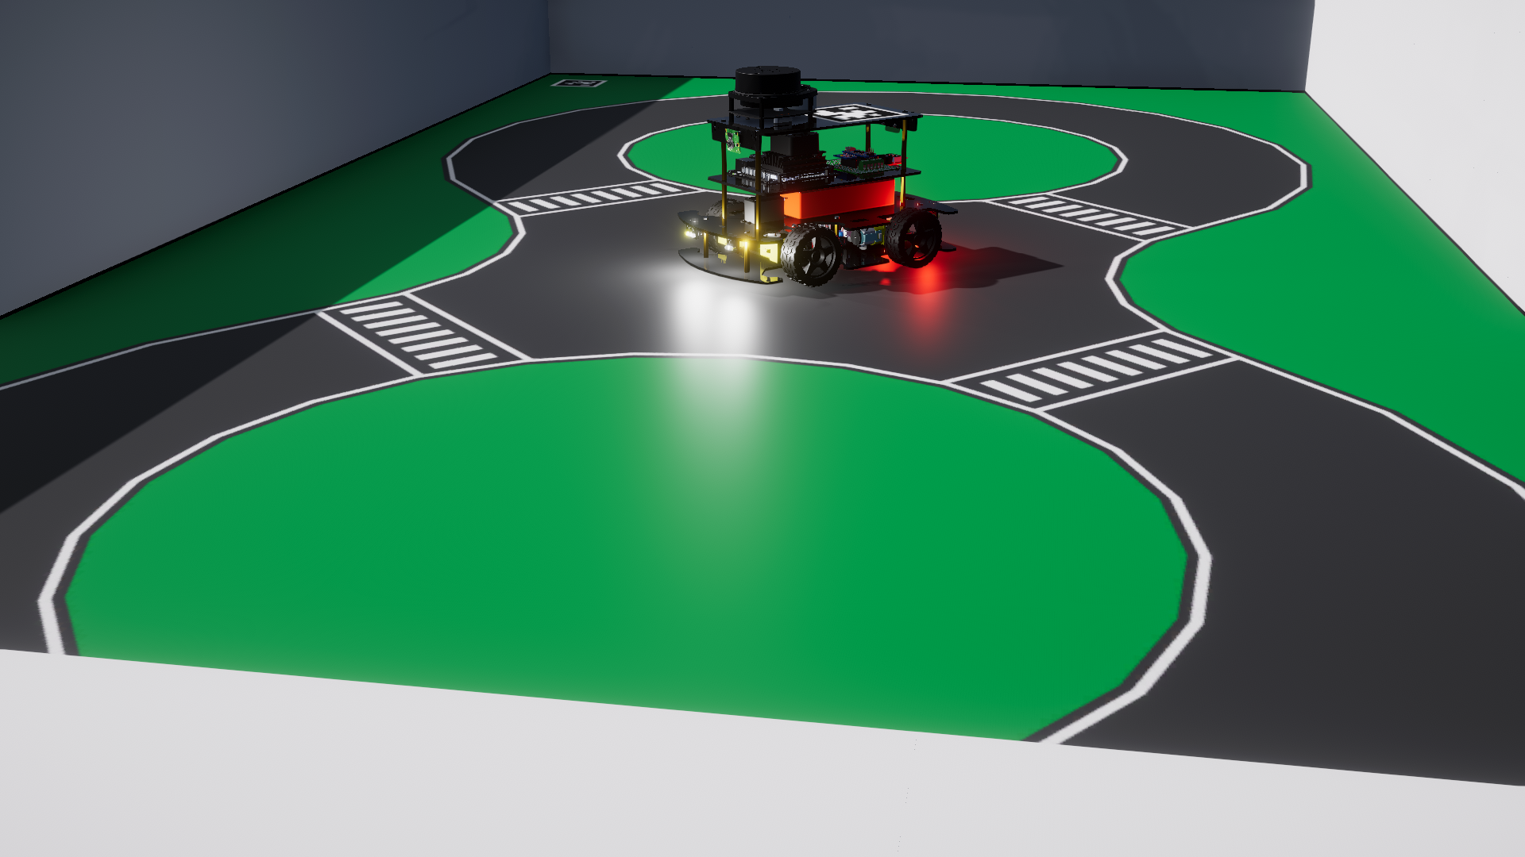
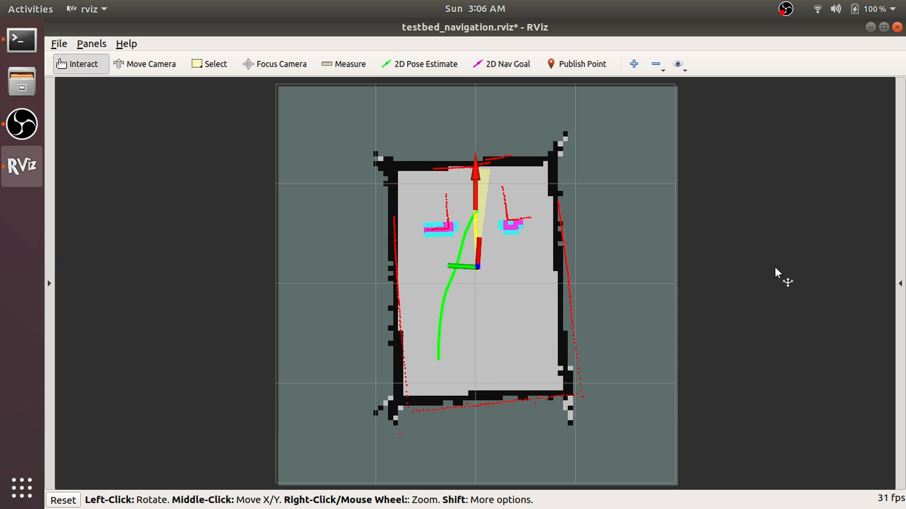
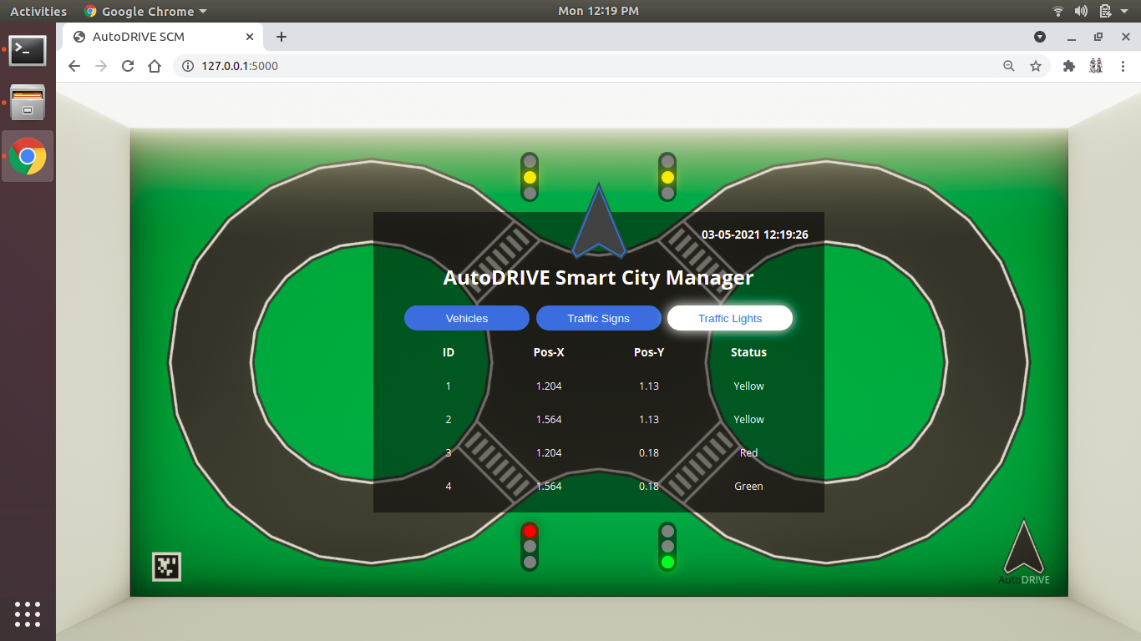
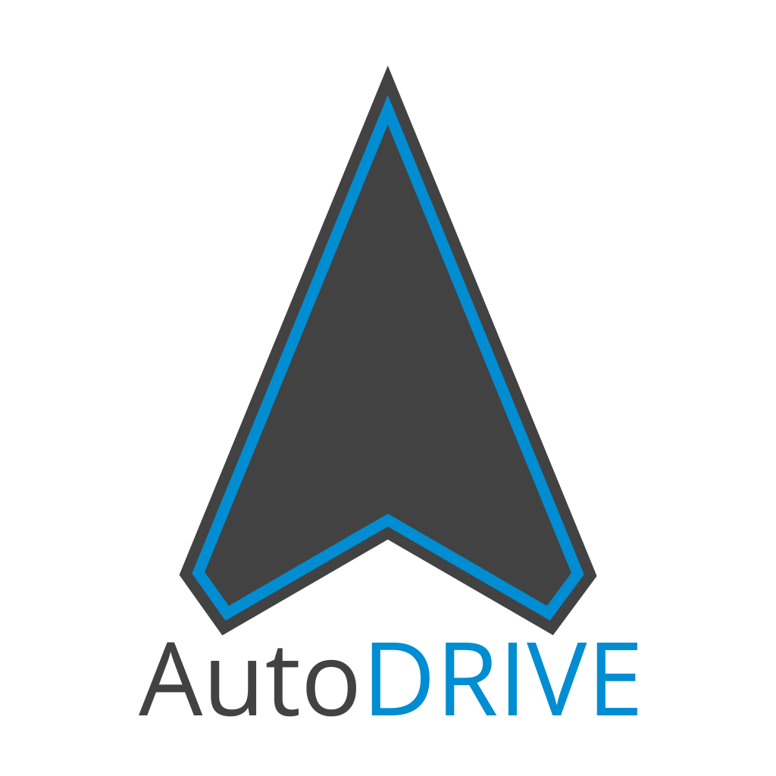
AutoDRIVE Ecosystem
Website
GitHub
YouTube
Ackermann-steer, skid-steer, independent 4WD4WS
1/14 scale open chassis
Scaled infrastructure
Small form factor
Flexible APIs
High-fidelity simulation
Mechatronic testbed
AD + SC applications
Affordable cost
Version | Mobile Base | Battery | Computer(s) | Sensor(s) | Actuator(s) | Developer | Release | Cost
Nigel | Open-Source | 5200 mAh | Jetson Nano or Jetson Orin Nano | RPLIDAR A-1, Pi-Cameras, Intel RealSense D435i, 9-Axis IMU, 6-Axis IPS, Encoders, Microphone, Steering Feedback, Throttle Feedback | DC Motors, Steering Servo(s) | CU-ICAR + NTU + SRMIST | 2021 | $450
=
Source: https://autodrive-ecosystem.github.io

Slide 3
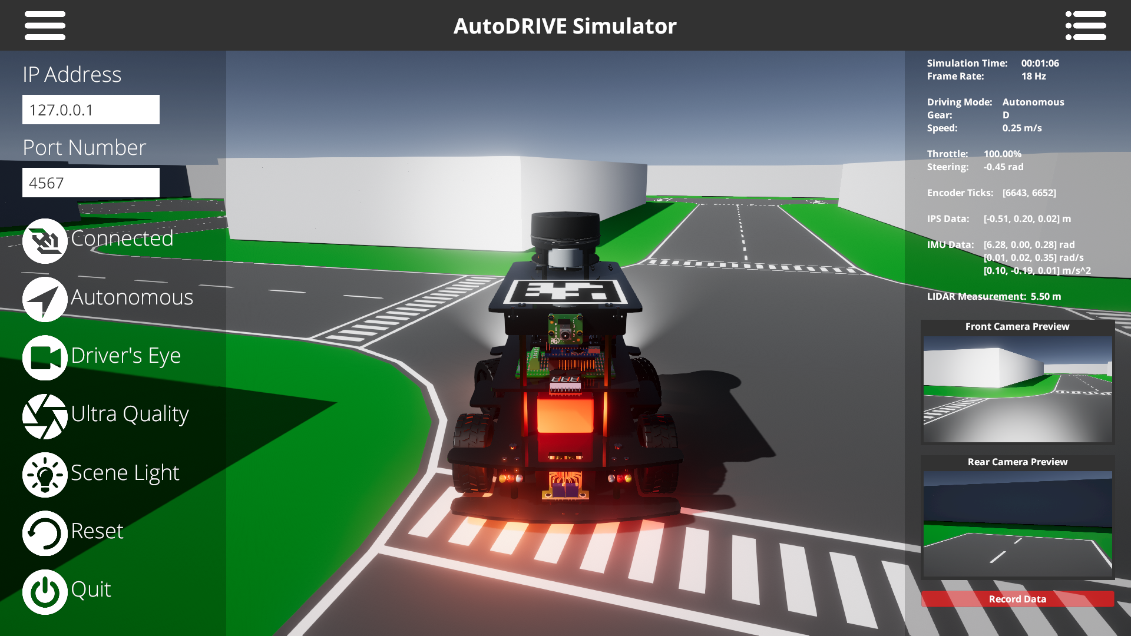
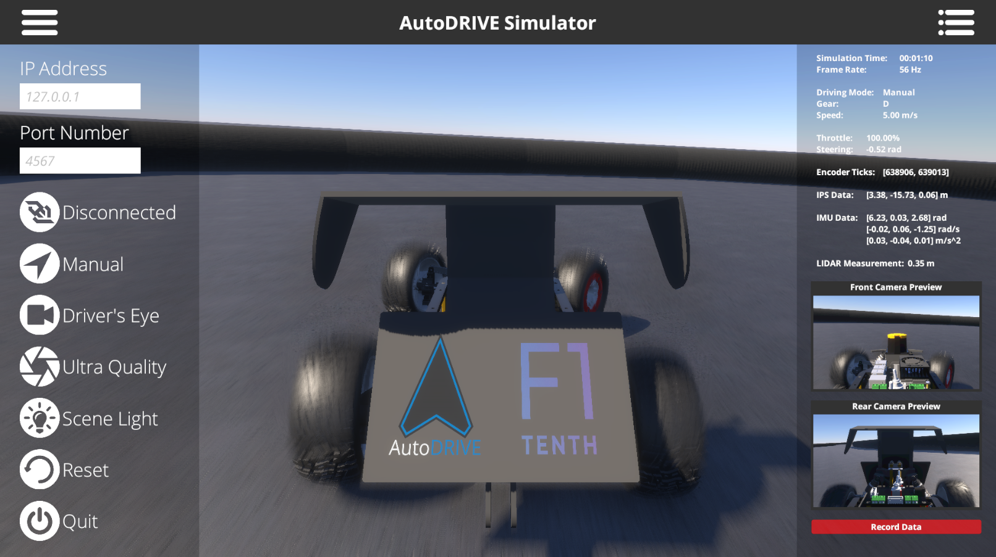
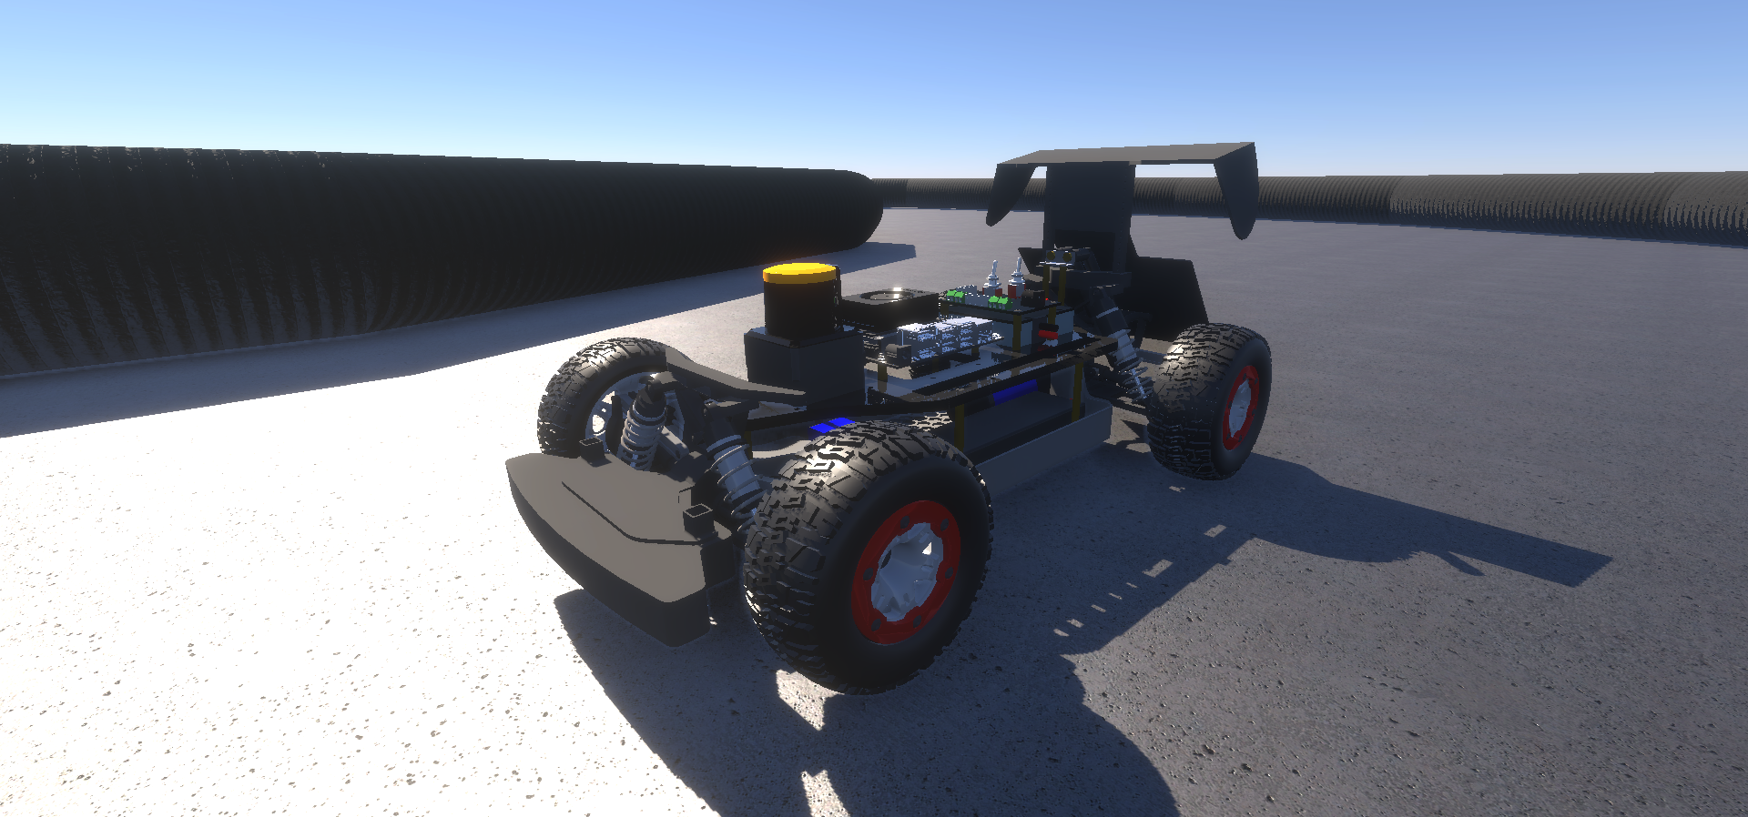
AutoDRIVE Simulator
Advantages
3D simulation environment
Photorealistic graphics
Realistic physics
Cross-platform support
Extended API support
On/off road AVs across scales
Disadvantages
Moderate compute requirements
Small development team
Source: AutoDRIVE Ecosystem
Simulation Quality | Physics Engine | Graphics Rendering | Vehicle Dynamics Support | Sensor Support | API Support | Developer | Cost | Open Source | Applications
3D | PhysX | Unity HDRP | Full car model for lateral, longitudinal, vertical and RPY dynamics with tire-terrain interaction | 2D/3D LIDAR, Camera, GNSS, IPS, IMU, Encoders Steering Feedback, Throttle Feedback, State Variables | ROS, ROS 2, Python, C++, MATLAB, Simulink, Webapp | CU-ICAR, NTU, SRMIST | Free | Yes | Exploration, education and research

Slide 4
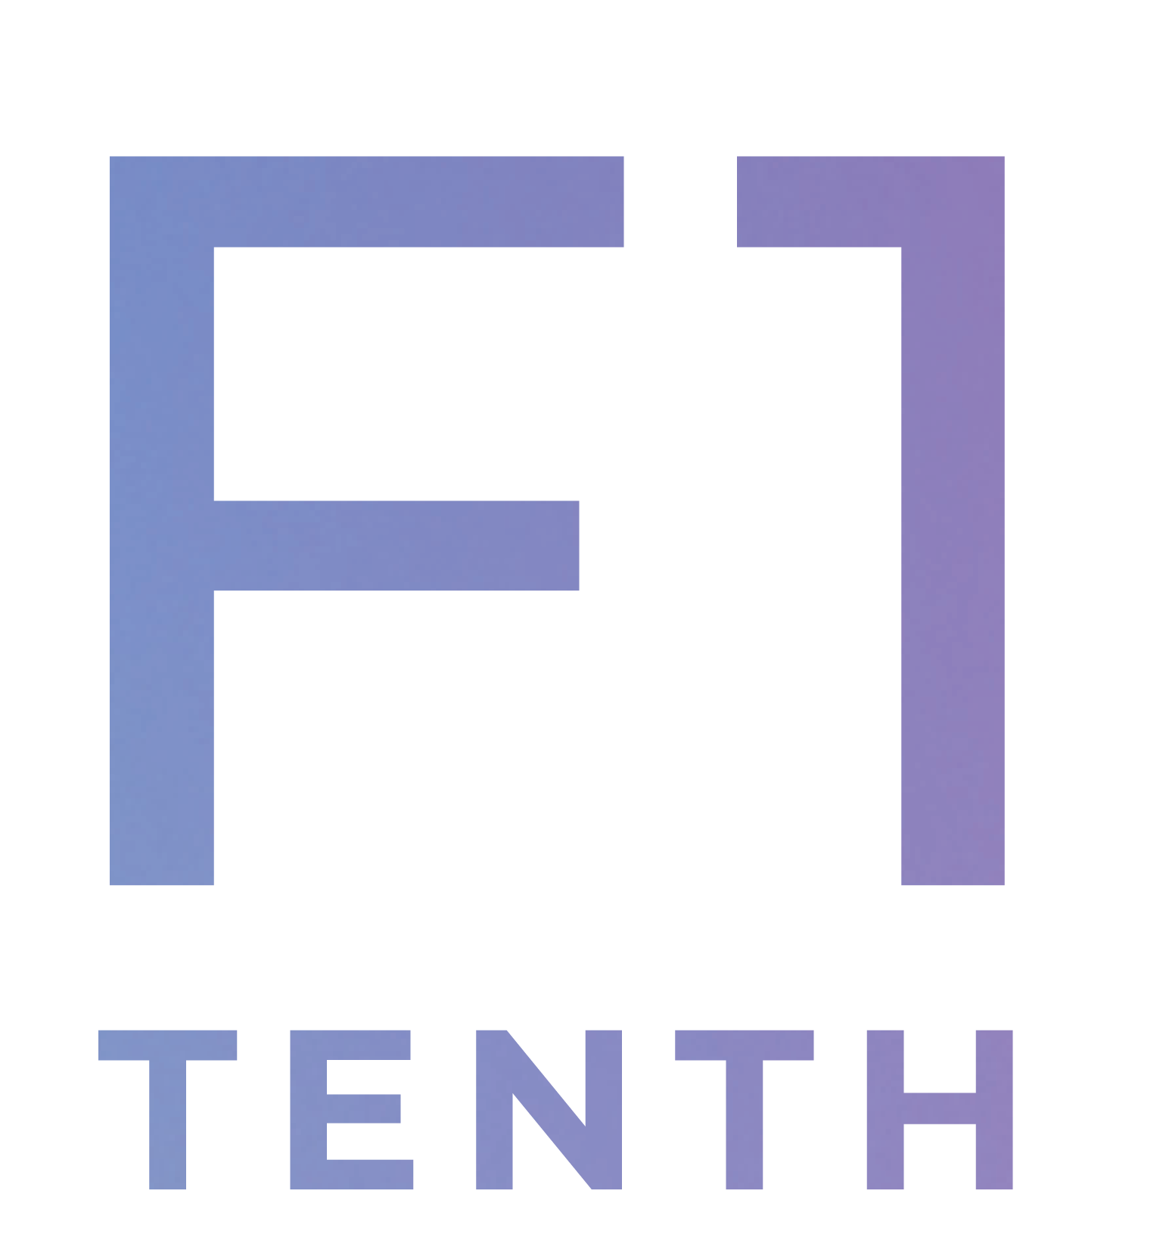
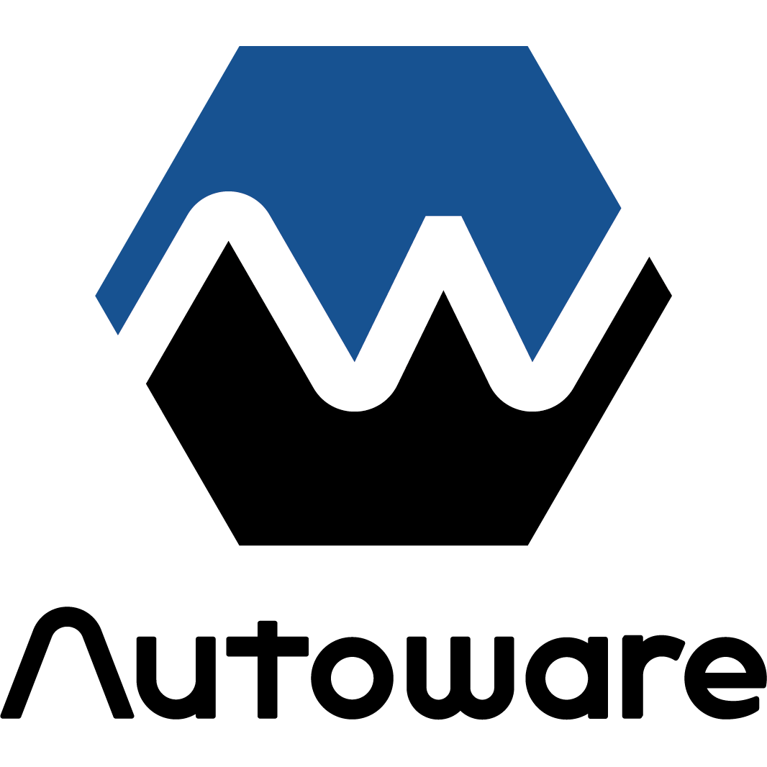
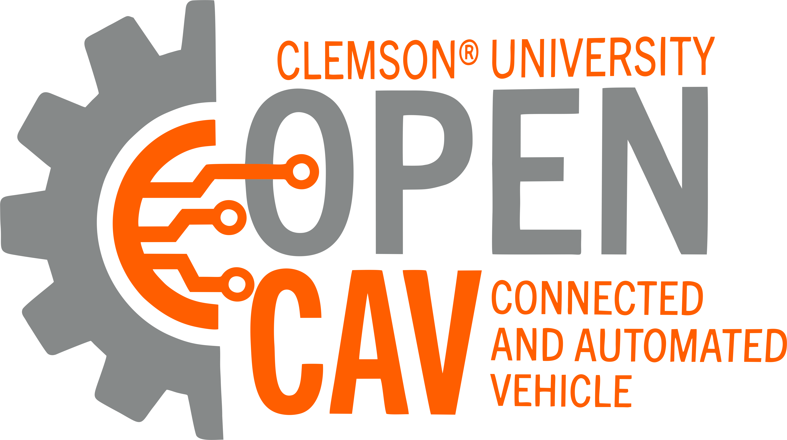
Planned Project Objectives
Theme: digital twins + vehicle scale + Autoware
ODD focus: on-road autonomous navigation
Platforms:
Small-scale: Nigel/F1TENTH
Full-scale: OpenCAV
Simulation: AutoDRIVE Simulator
Software-stack: Autoware
True digital twin framework:
Immersive teleoperation demo
Autoware demo:
Autonomous navigation (waypoint following)
Documentation

Slide 5
Planned Project Objectives
AuE-8360 Capstone Project (Fall 2023)
Task | 10/18 | 10/25 | 11/01 | 11/08 | 11/15 | 11/22 | 11/29 | 12/06
Announcements
Project Proposal
Phase 1
Phase 2
Phase 3
Project Presentation
Project Report

Slide 6
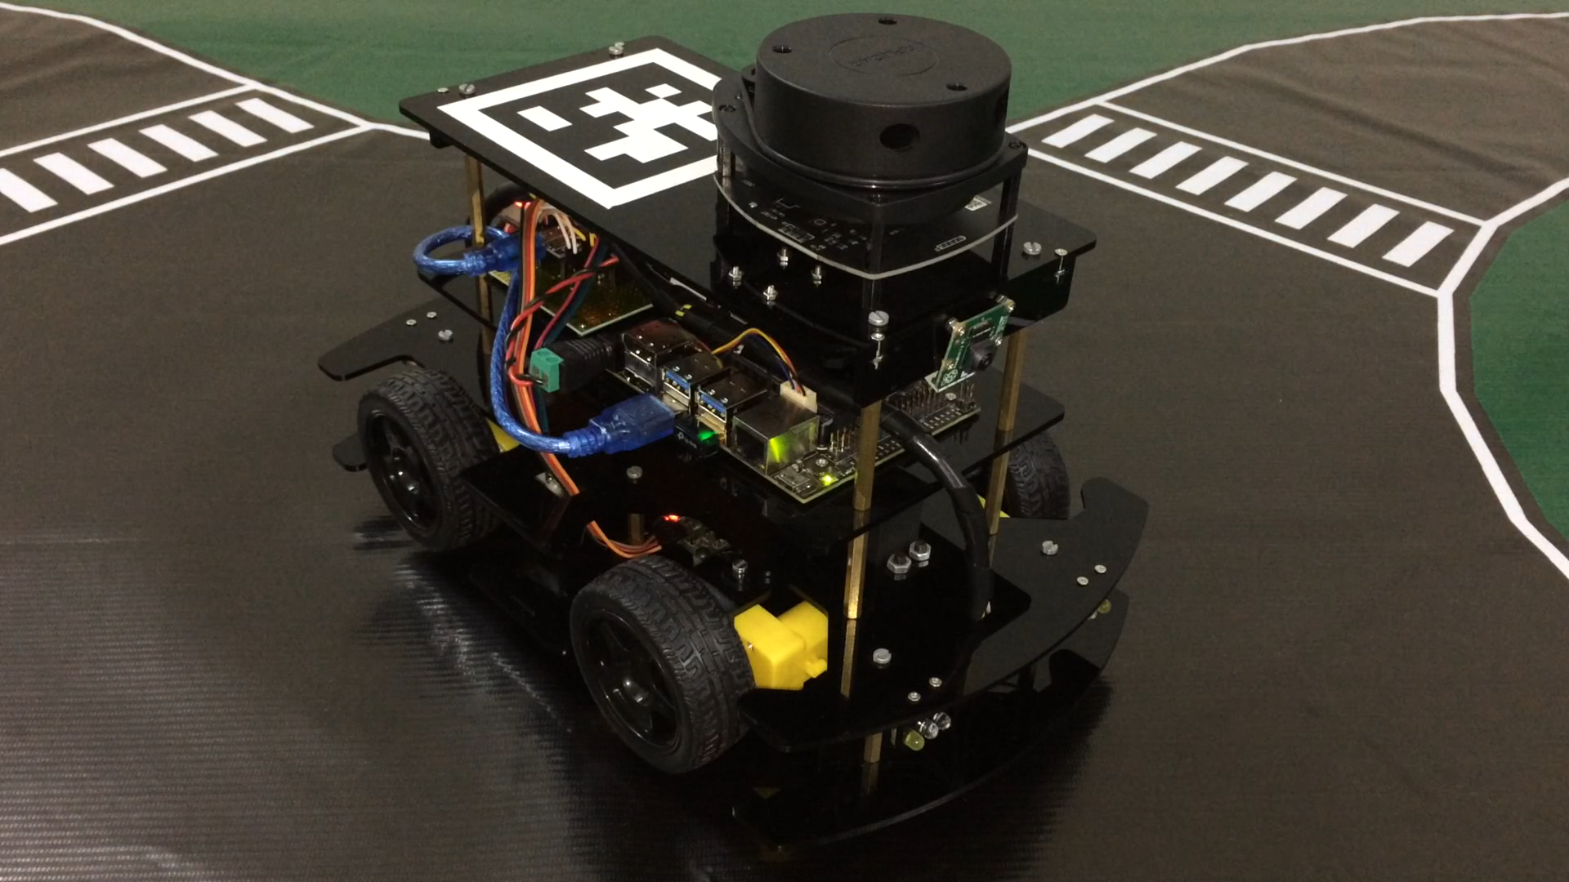
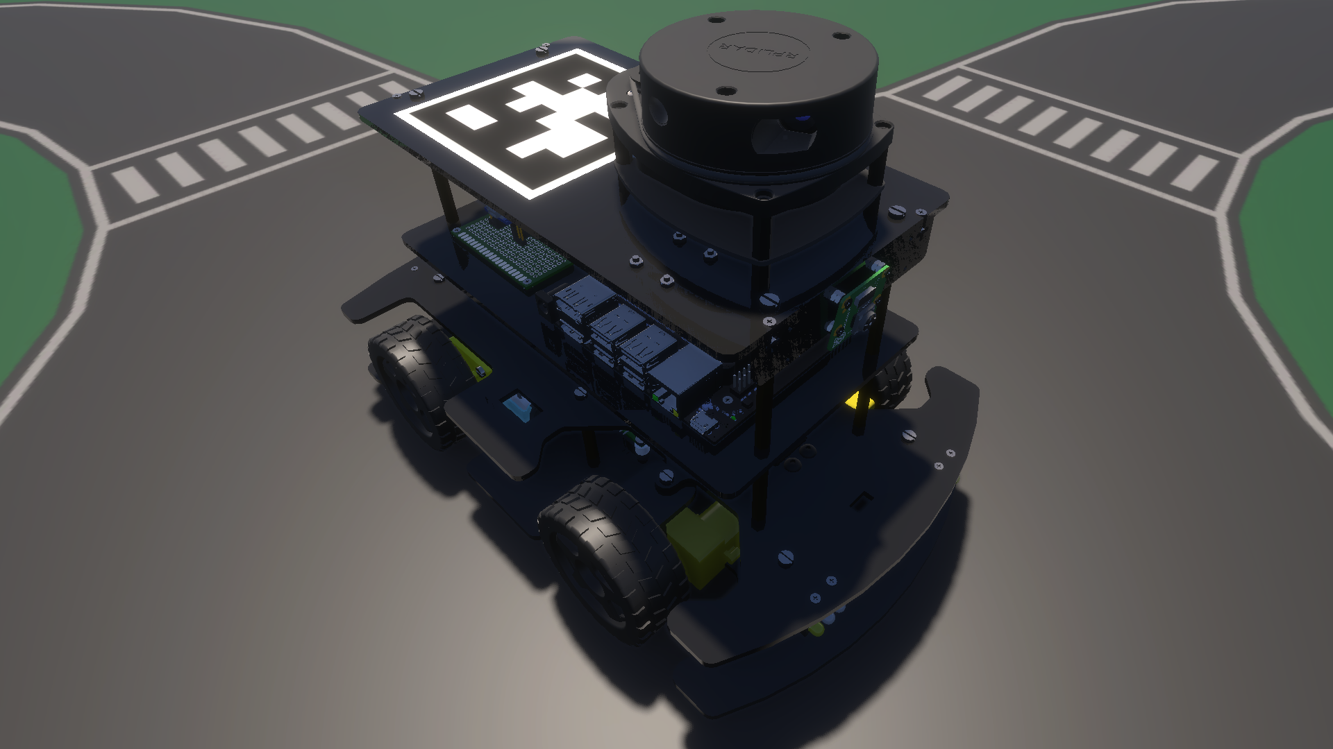
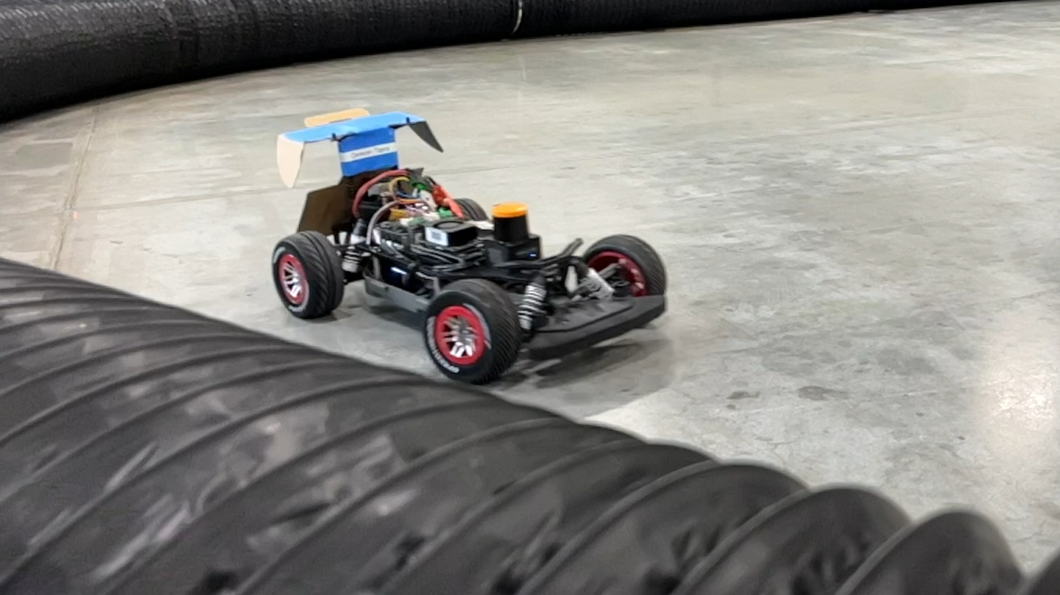
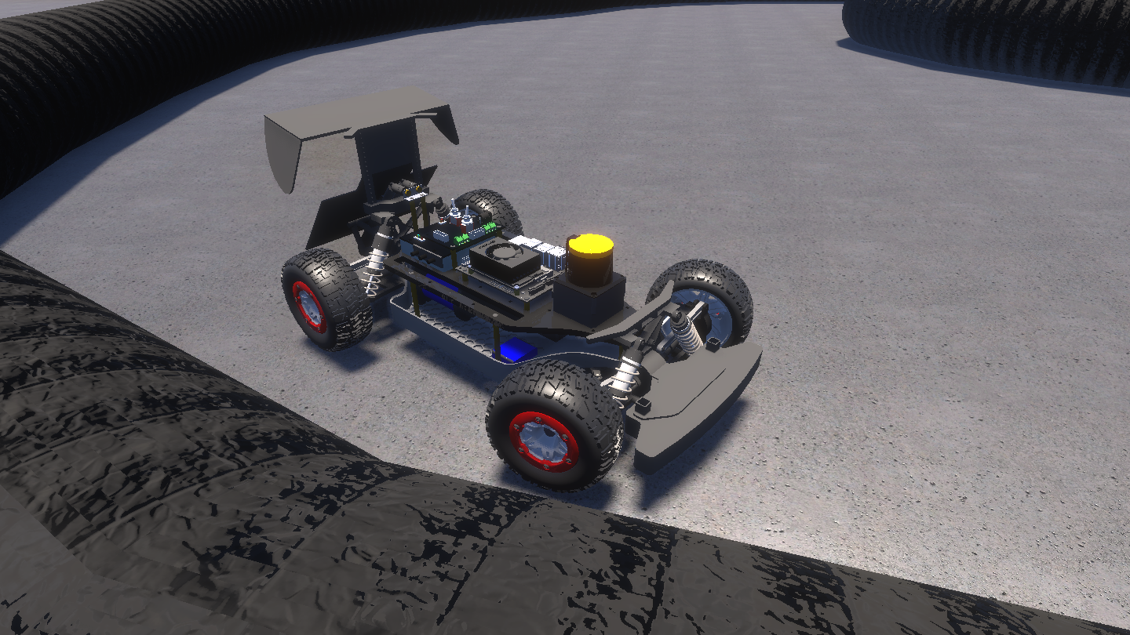
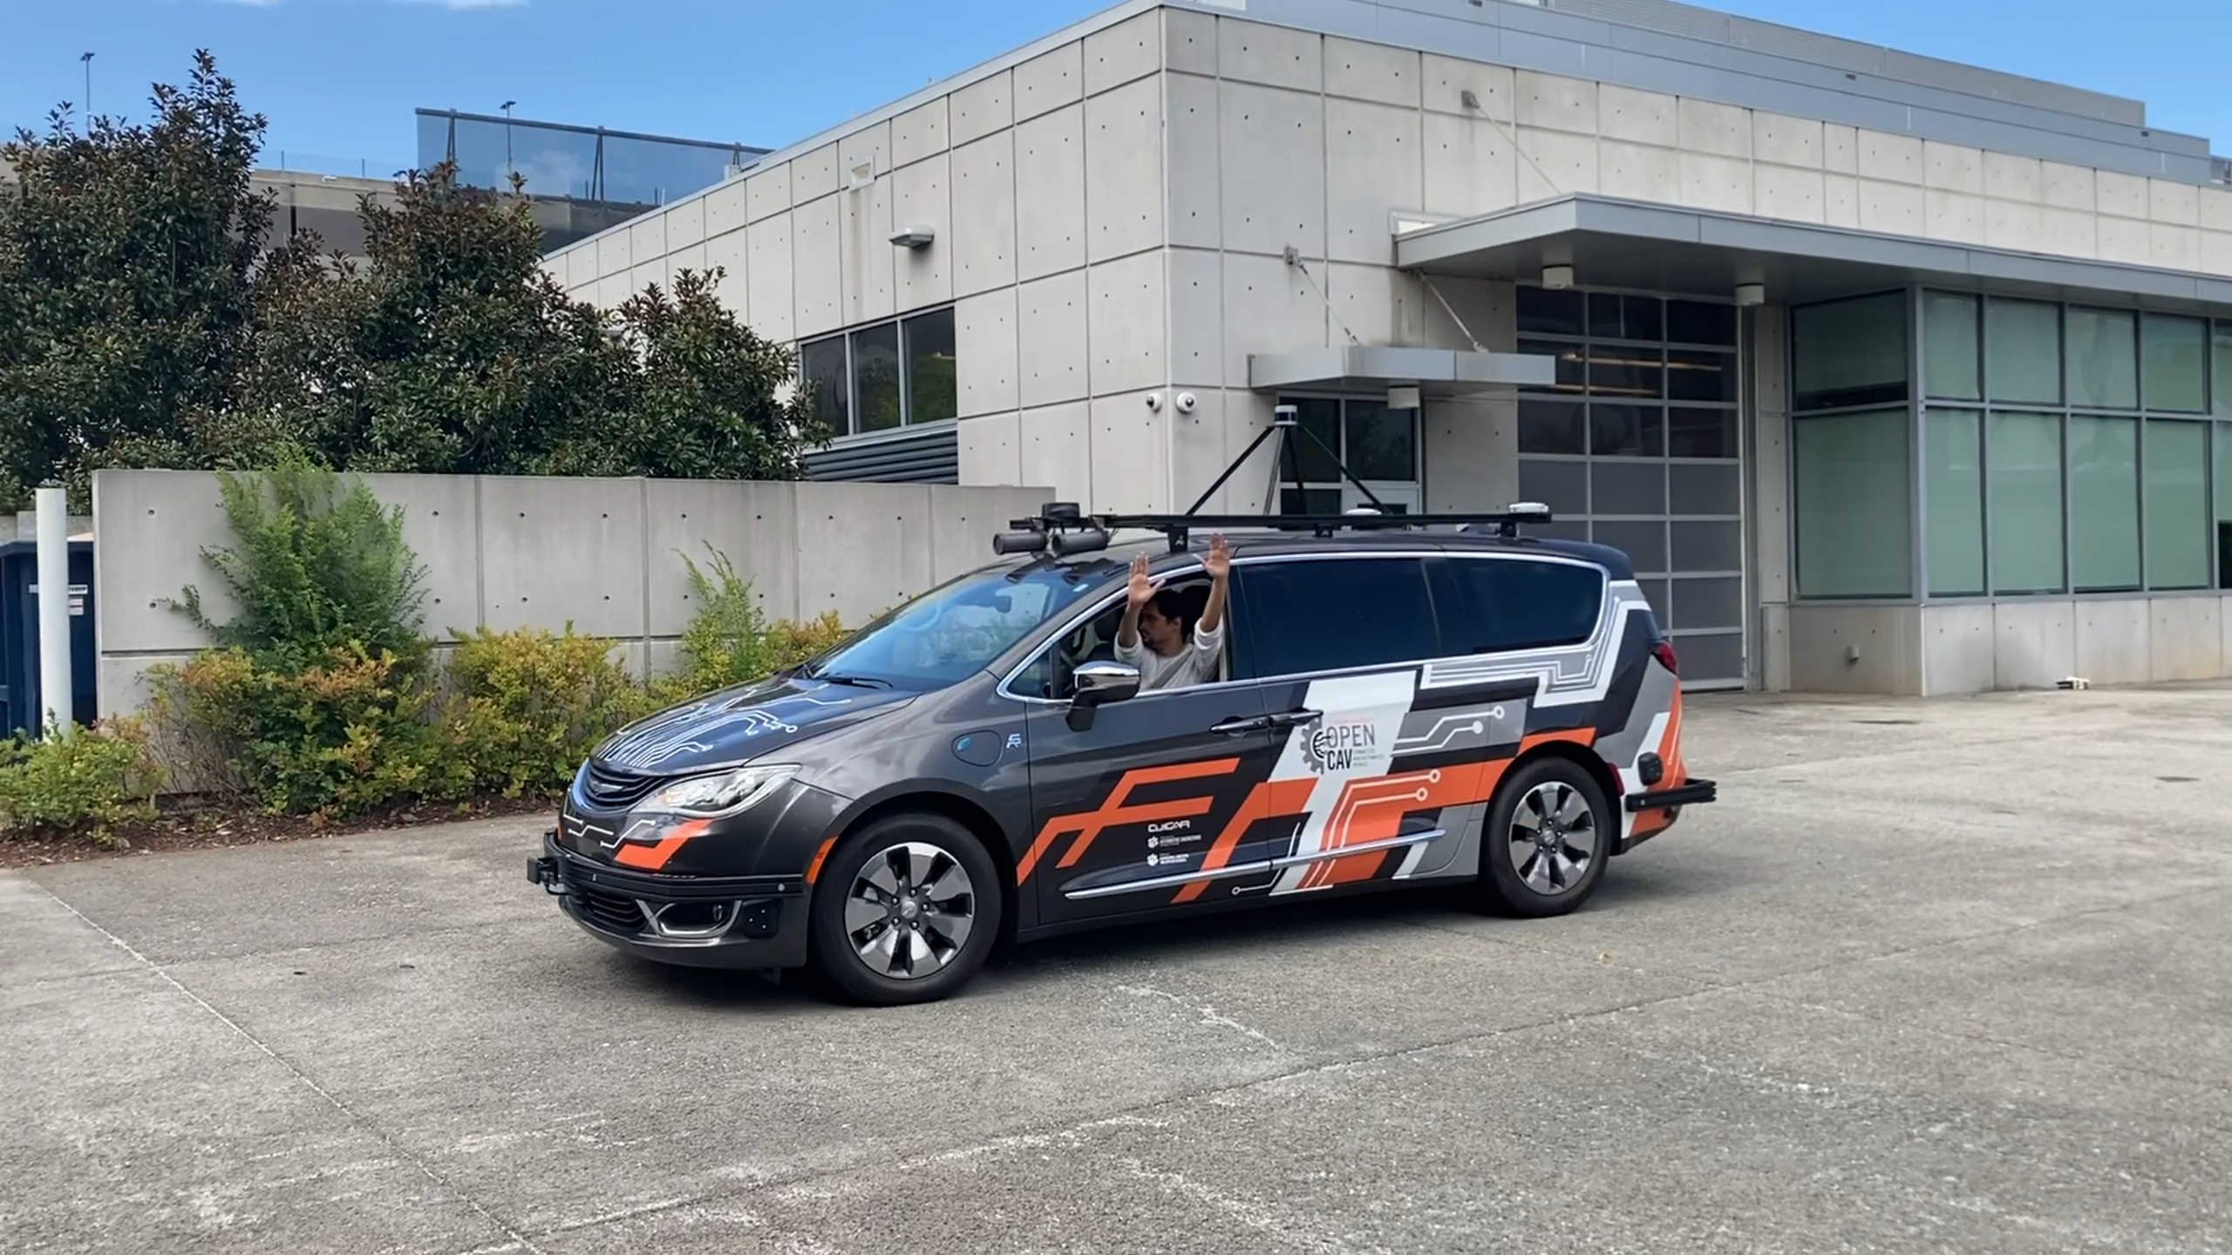
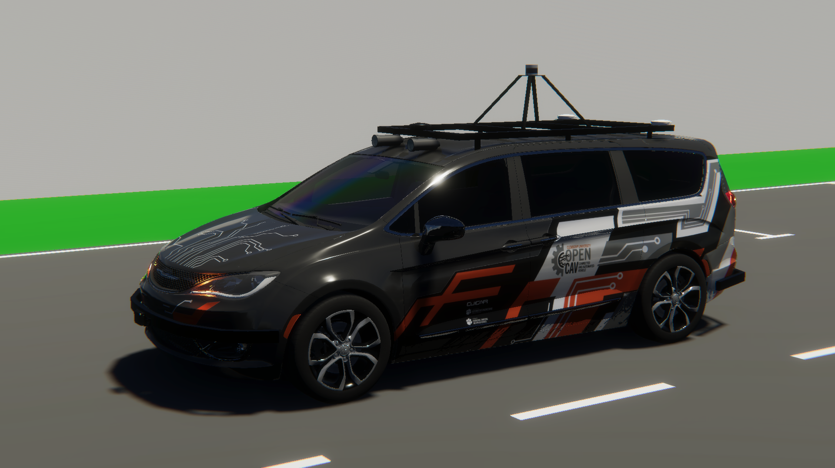
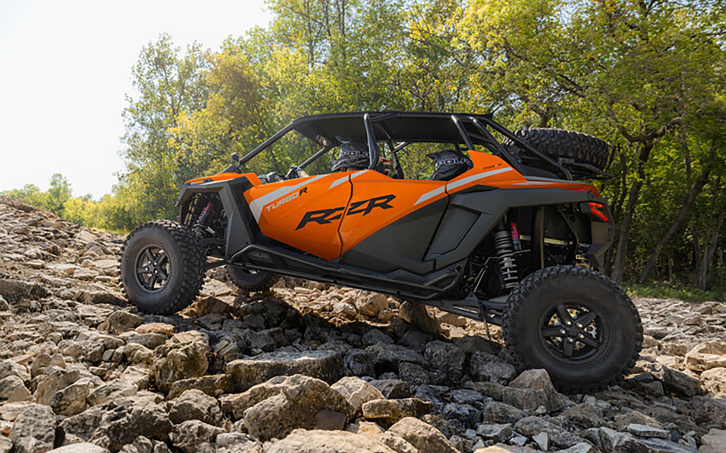
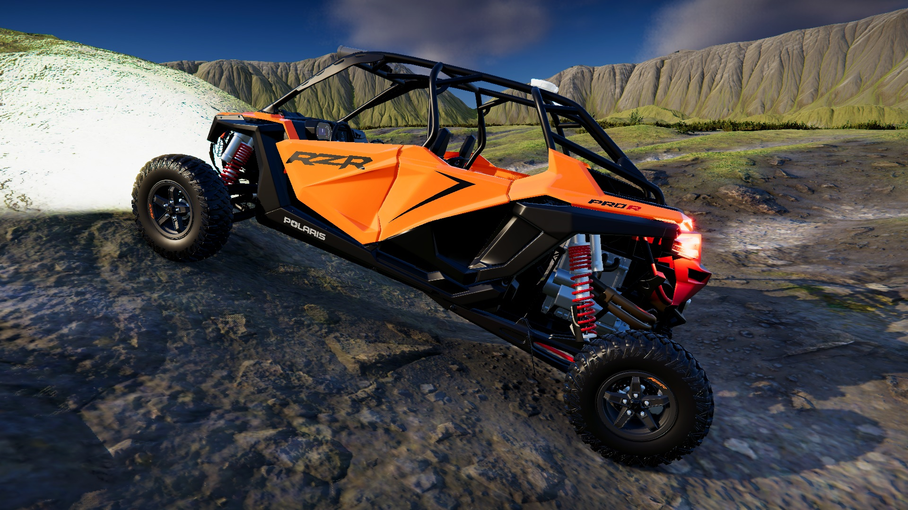
Digital Twin Models in AutoDRIVE Ecosystem
Nigel (Native Scaled Vehicle)
F1TENTH (Scaled Vehicle)
OpenCAV (On-Road Full Scale Vehicle)
RZR (Off-Road Full Scale Vehicle)
Source: AutoDRIVE Ecosystem

Slide 7
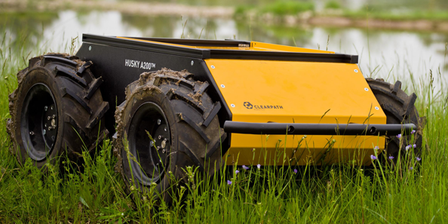
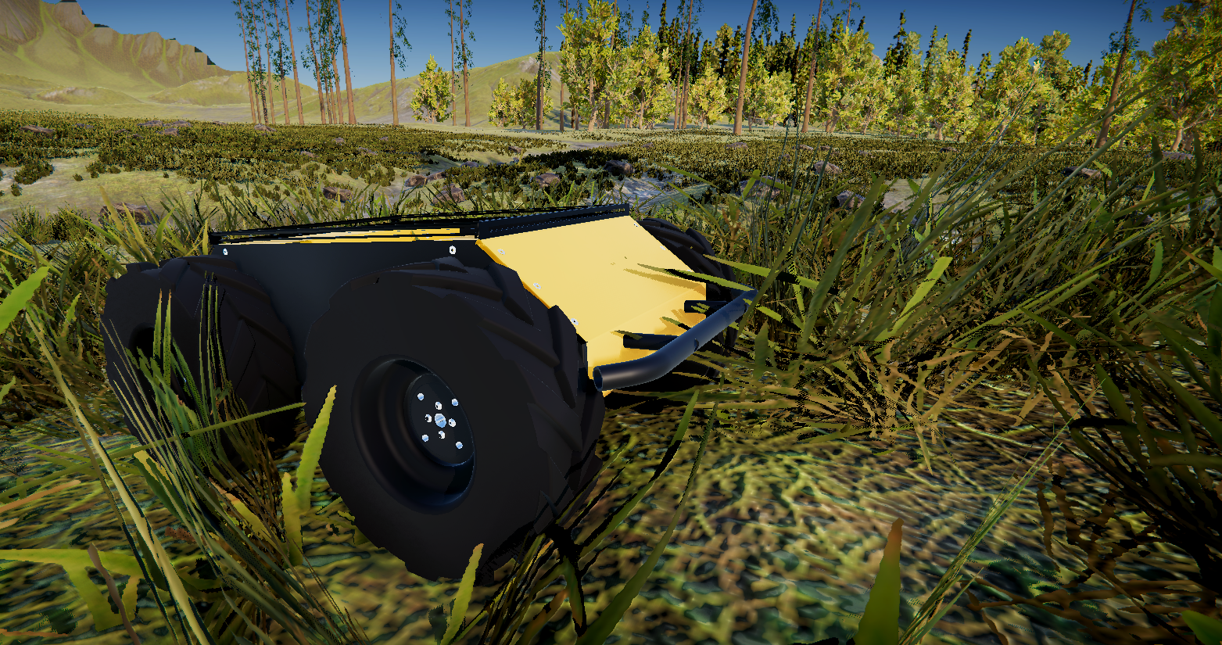
Digital Twin Models in AutoDRIVE Ecosystem
Husky (Off-Road Mid Scale Vehicle)
Source: AutoDRIVE Ecosystem

Slide 8
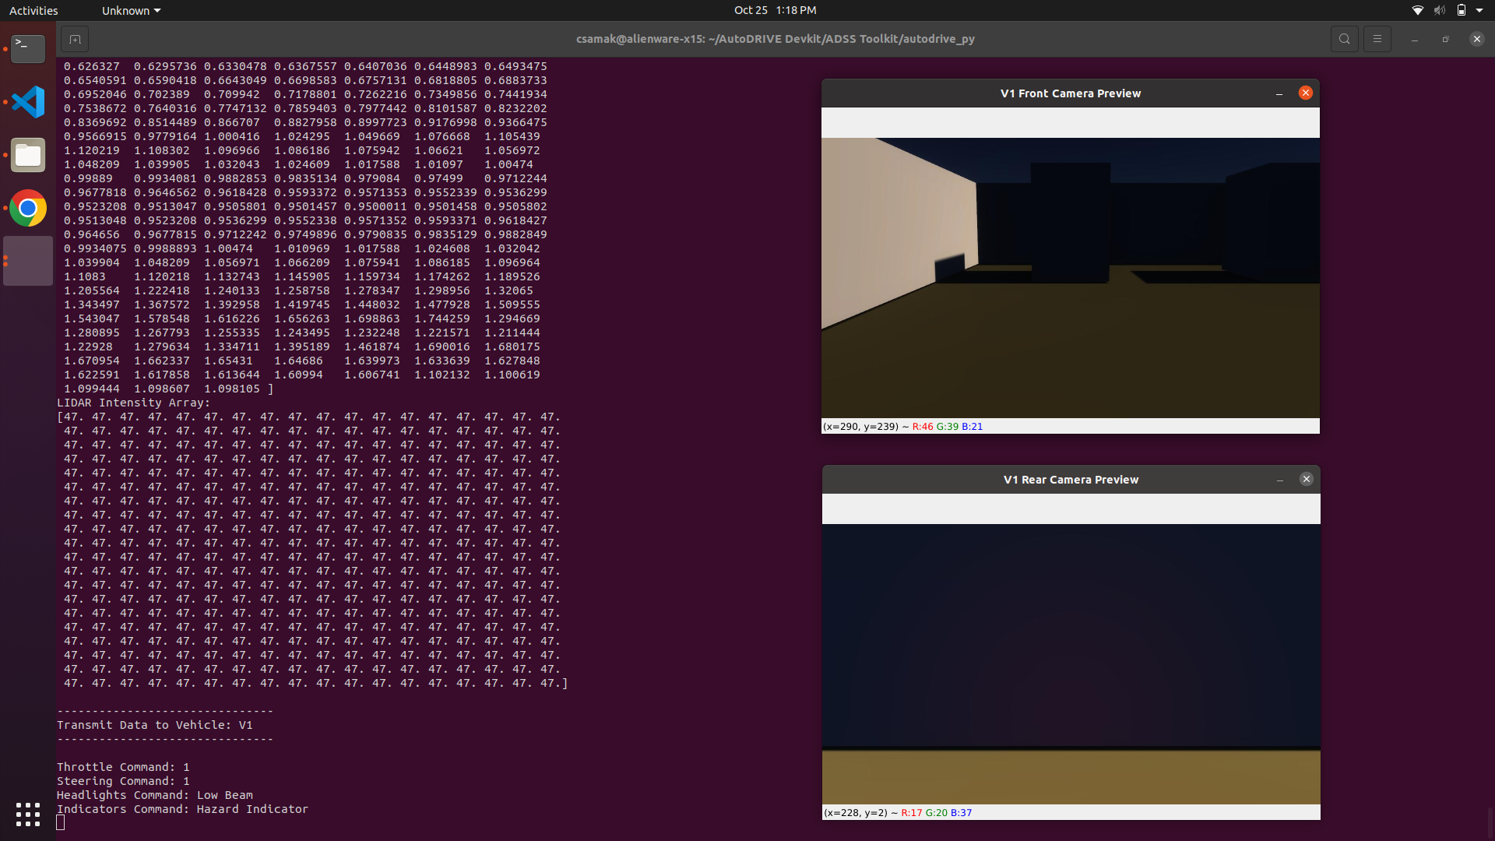
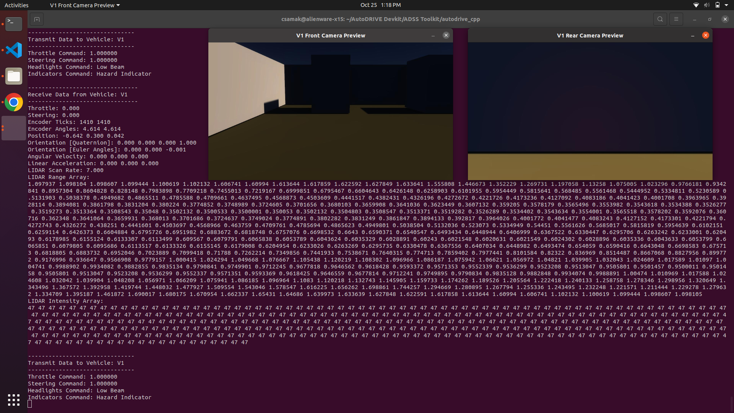
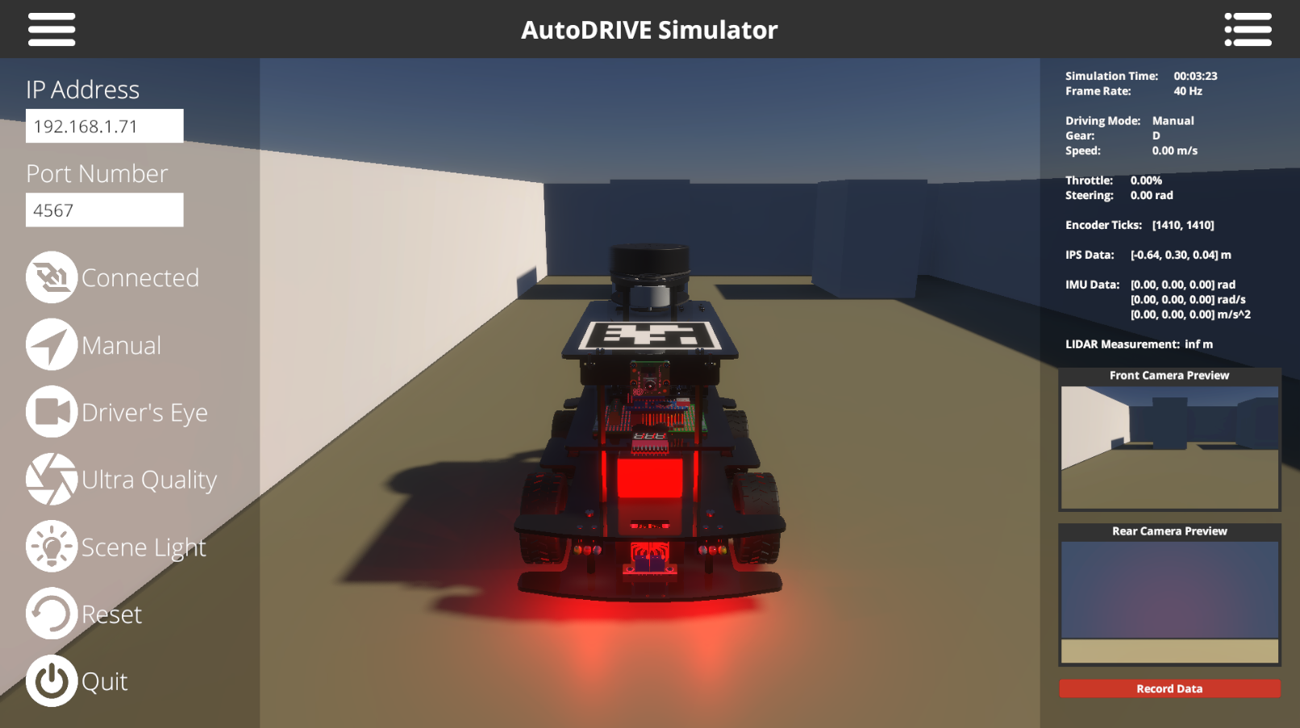

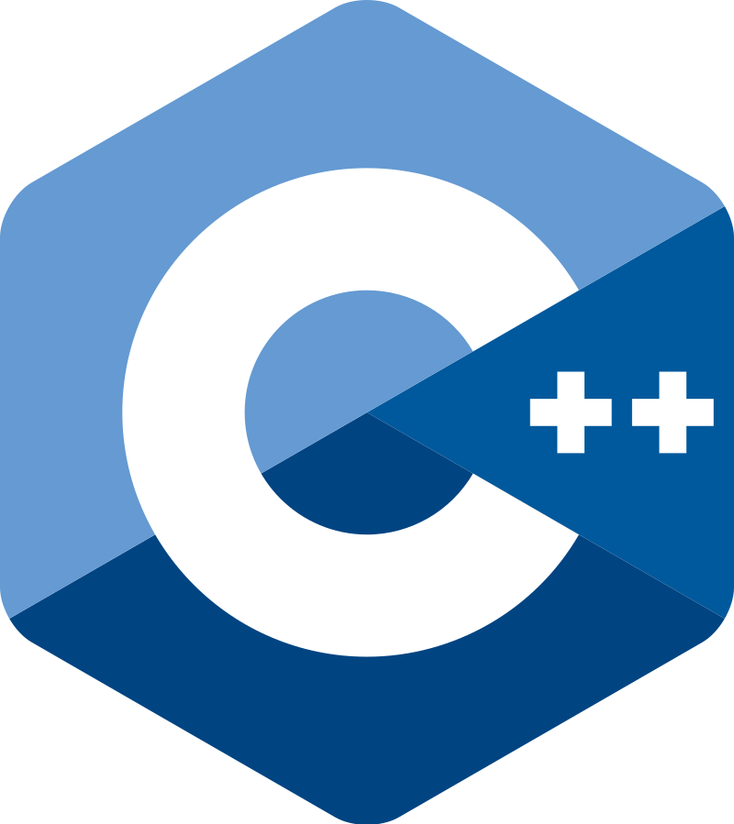
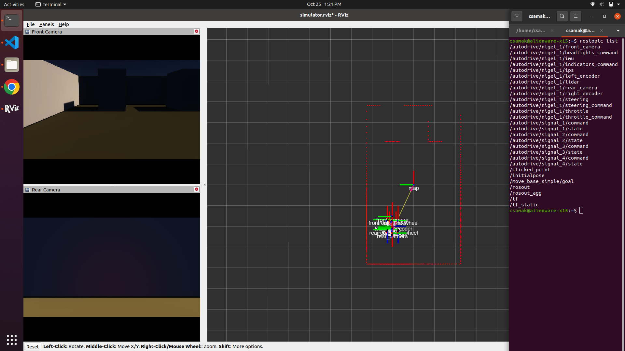
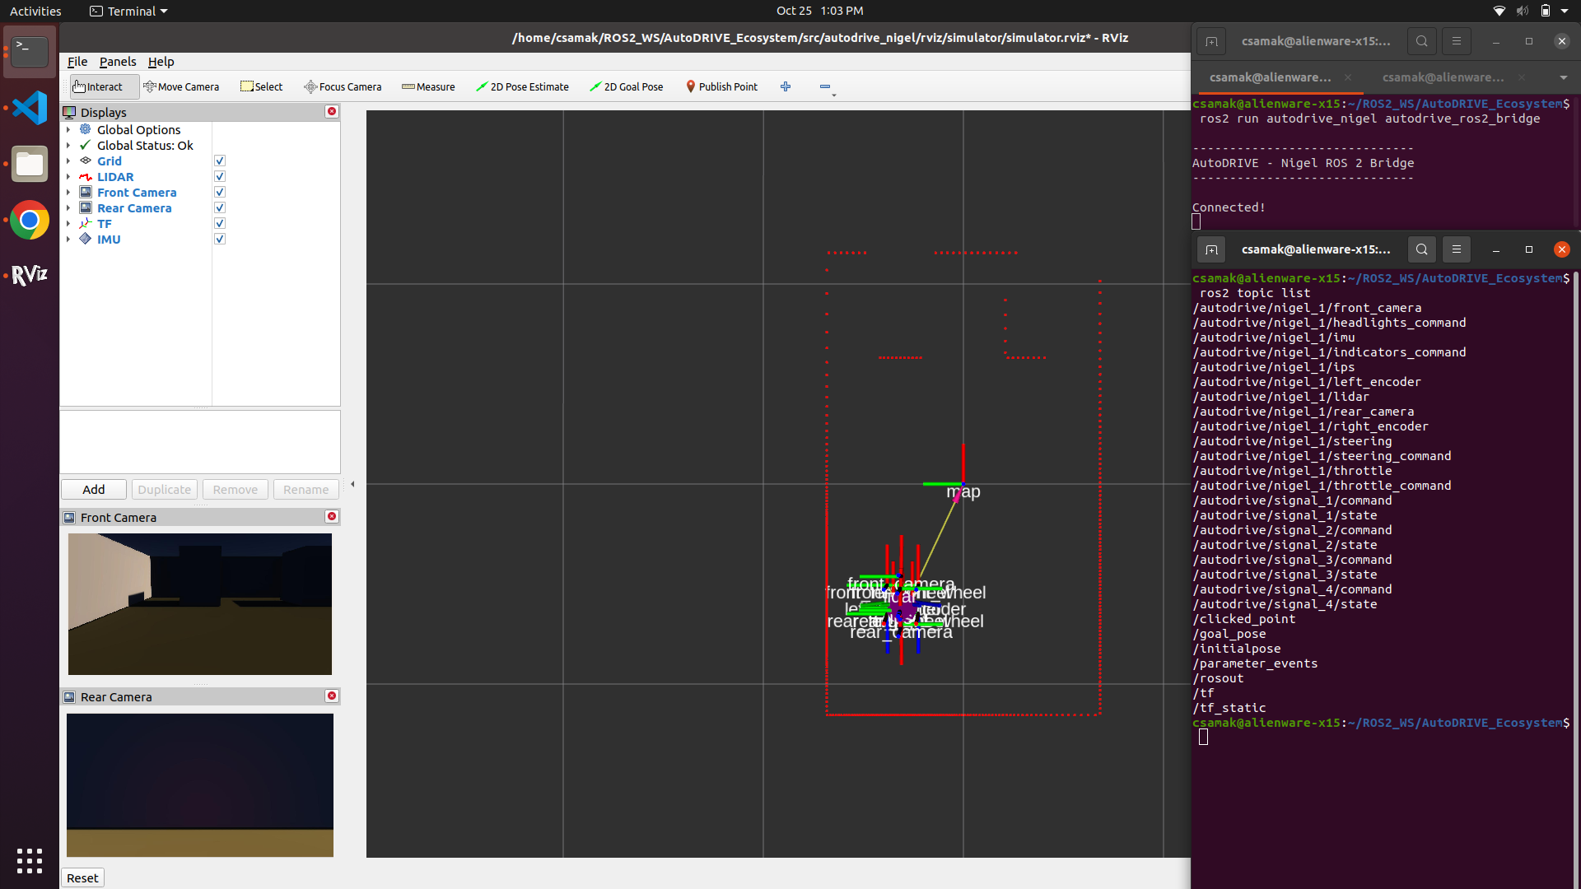


APIs to connect with AutoDRIVE Ecosystem
Python
C++
AutoDRIVE
ROS
ROS 2

Slide 9
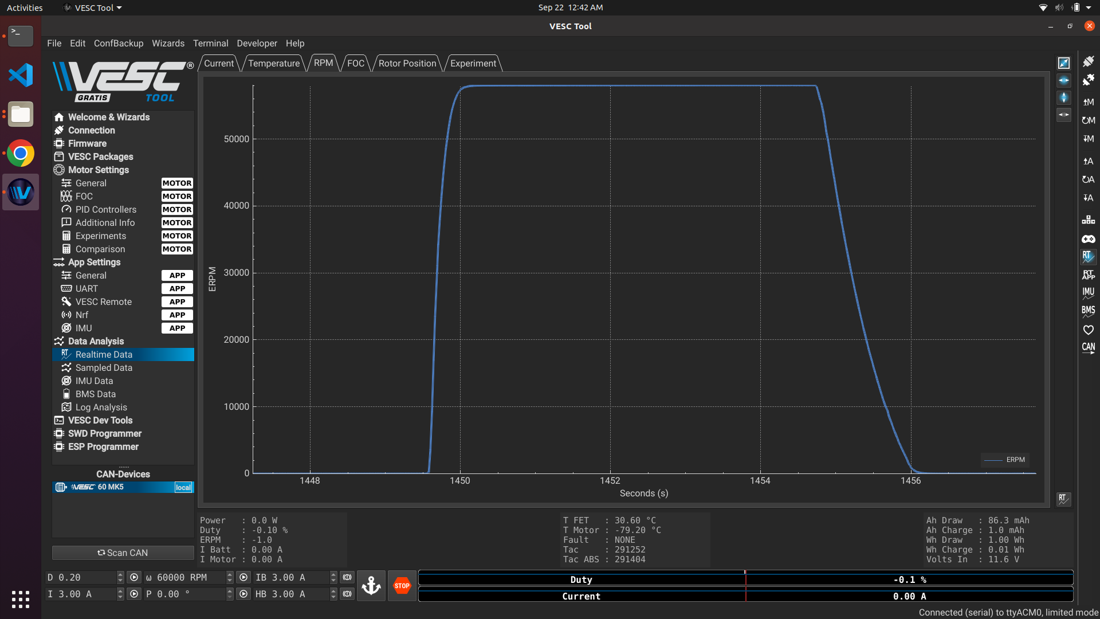
F1TENTH Vehicle Setup
DONE:
Simulation API setup
Test, backup and retire old “racing” vehicle
Setup new vehicle hardware (SAE Car 3)
Configure new vehicle software (L4T Ubuntu 18.04 + ROS Melodic + F1TENTH & AutoDRIVE Stacks)
Replace “good” wheels/tires
Test RP codebase on new vehicle (IV2023 approach)
Test MARP codebase on new vehicle (IROS2023 approach)
TODO:
Upgrade L4T version (+JetPack) and install Autoware
Potential L4T flashing issue on F1TENTH
Debugging/dockerized version of Autoware

Slide 10
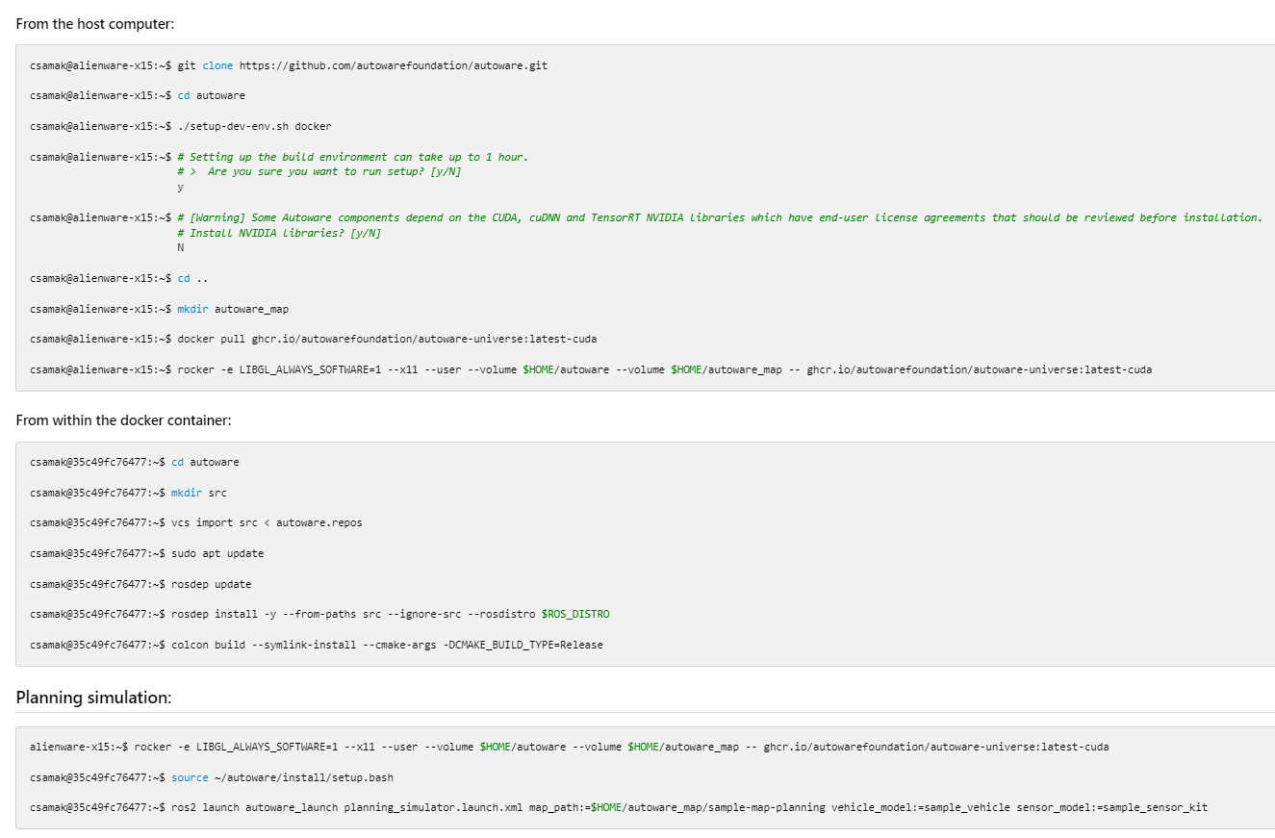
Dockerized Version of Autoware Core/Universe
DONE:
Installed, tested and explored Autoware with Dockerized approach
Nuances with directory structuring and file organization
Autoware path planning example demo
TODO:
Test local installation with Ubuntu 22.04 + ROS 2 Humble
Integrate with AutoDRIVE’s ROS 2 API

Slide 11
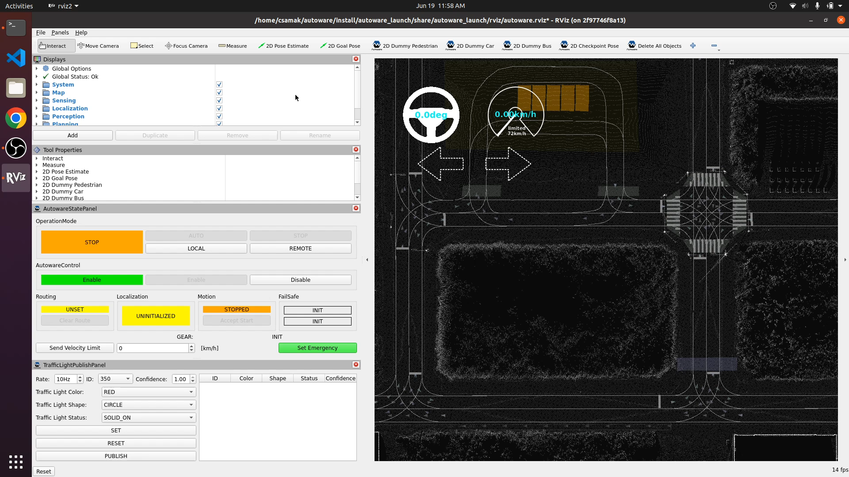
Dockerized Version of Autoware Core/Universe
DONE:
Installed, tested and explored Autoware with Dockerized approach
Nuances with directory structuring and file organization
Autoware path planning example demo
TODO:
Test local installation with Ubuntu 22.04
Integrate with AutoDRIVE’s ROS 2 API

Slide 12
References
T. Samak, C. Samak, S. Kandhasamy, V. Krovi, and M. Xie, “AutoDRIVE: A Comprehensive, Flexible and Integrated Digital Twin Ecosystem for Autonomous Driving Research & Education,” Robotics, vol. 12, no. 3, p. 77, May 2023, doi: 10.3390/robotics12030077
W. Ding, C. Xu, M. Arief, H. Lin, B. Li and D. Zhao, “A Survey on Safety-Critical Driving Scenario Generation—A Methodological Perspective,” in IEEE Transactions on Intelligent Transportation Systems, vol. 24, no. 7, pp. 6971-6988, July 2023, doi: 10.1109/TITS.2023.3259322
M. Quigley, K. Conley, B. Gerkey, J. Faust, T. Foote, J. Leibs, R. Wheeler, and A. Ng, “ROS: an open-source Robot Operating System,” in ICRA 2009 Workshop on Open Source Software, vol. 3, Jan 2009. [Online]. Available: http://robotics.stanford.edu/~ang/papers/icraoss09-ROS.pdf
S. Macenski, T. Foote, B. Gerkey, C. Lalancette, and W. Woodall, “Robot operating system 2: Design, architecture, and uses in the wild,” Science Robotics, vol. 7, no. 66, p. eabm6074, 2022. [Online]. Available: https://www.science.org/doi/abs/10.1126/scirobotics.abm6074
Autoware Foundation, “Autoware Project: The world’s leading open-source software project for autonomous driving.” [Online]. Available: https://autoware.org

